Slide 1
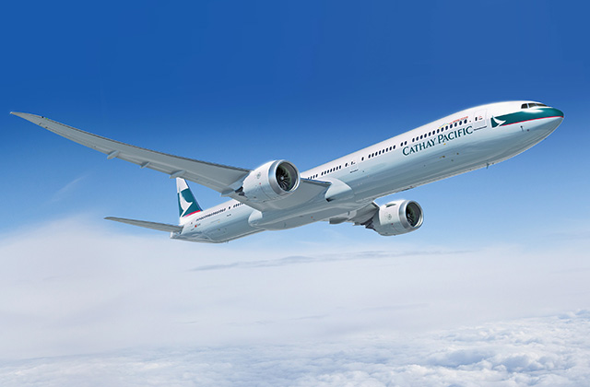
CX Chatbot

Slide 2


Problems that encountered
Complex
Not Efficient

Slide 3
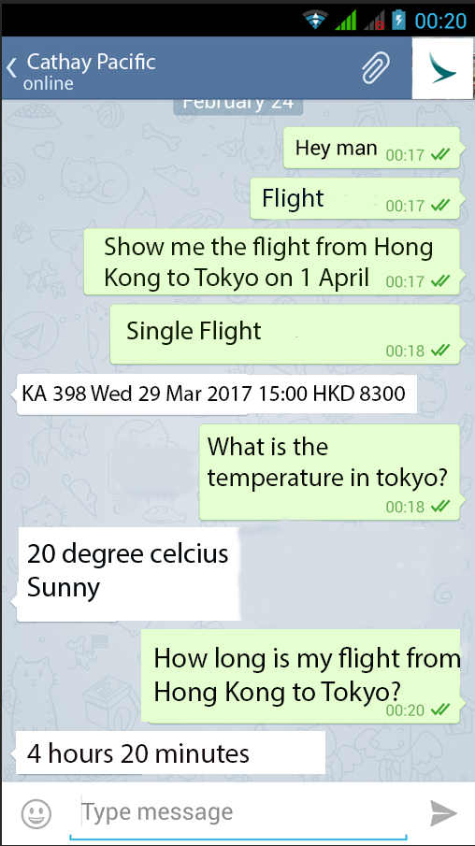
Solution

Slide 4




Functions for Pre Flight
Weather
Ticket Fee
Flight Schedule

Slide 5
Demonstration

Slide 6
Future Development
Connect to the database (KBQA system)
In-app payment
Memorize the history
Pre-flight assistants

Slide 7

Conclusions
One touch point
Increase Efficient

